Slide 1

GIT AND TONIC
Isabelle De Brabanter, Jeffrey Tsang, Jungwon Shin, Grace Song, Priya Kankanhalli, Angela Zheng

Slide 2
Goal and Target Audiences
Goal: To create a general tracking app
People who want to track academic tasks
People who want to track spending
People who want to track medicine usage (etc. daily vitamins)
How does our design address our audiences?
Ability to track task completion
Ability to visualize progress through analytics
Ability to set a repeated task
Notes:
Jungwon

Slide 3
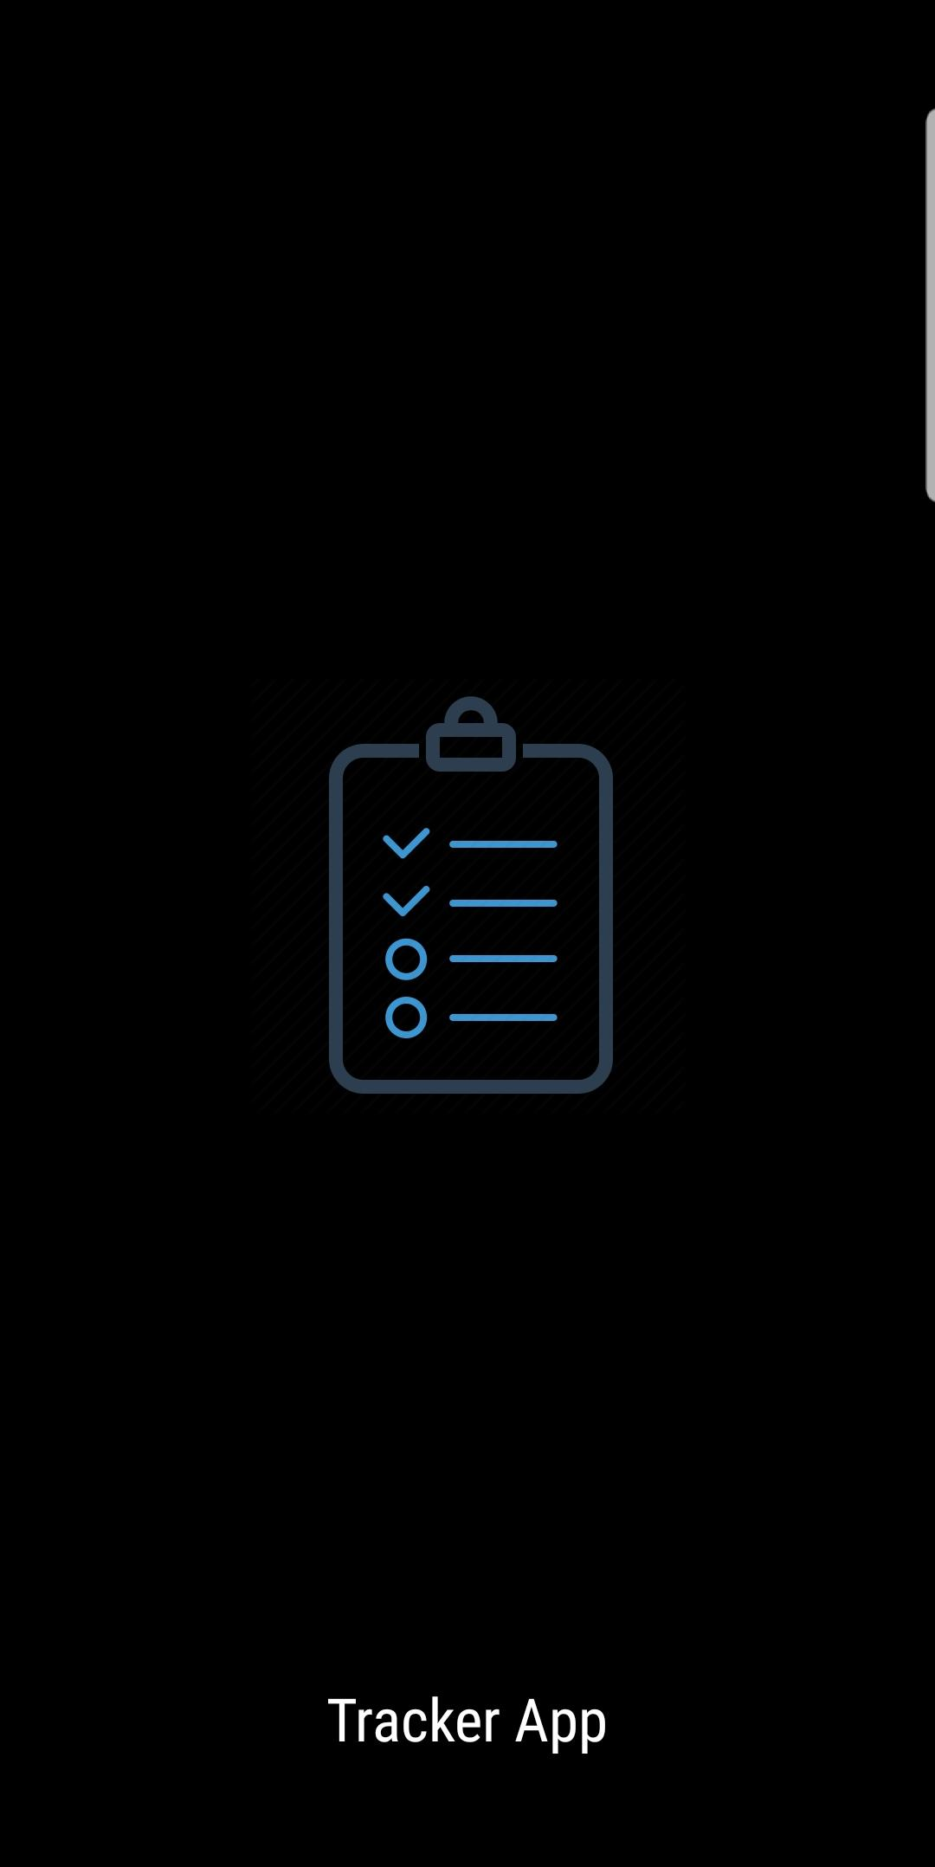
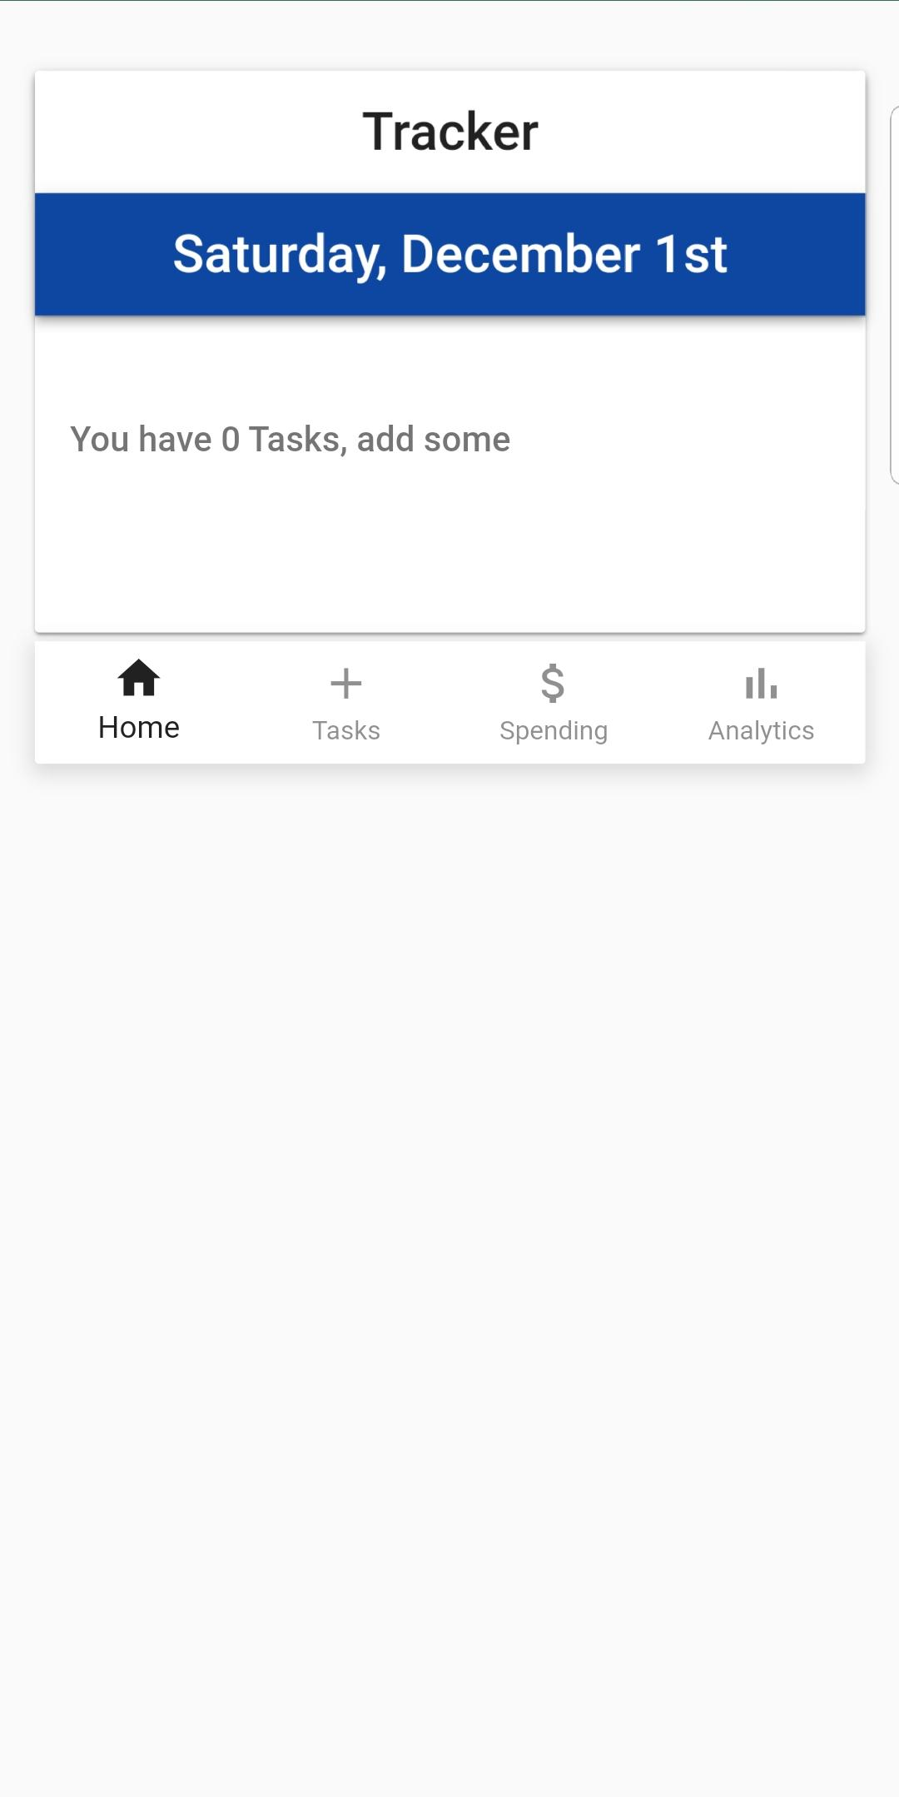
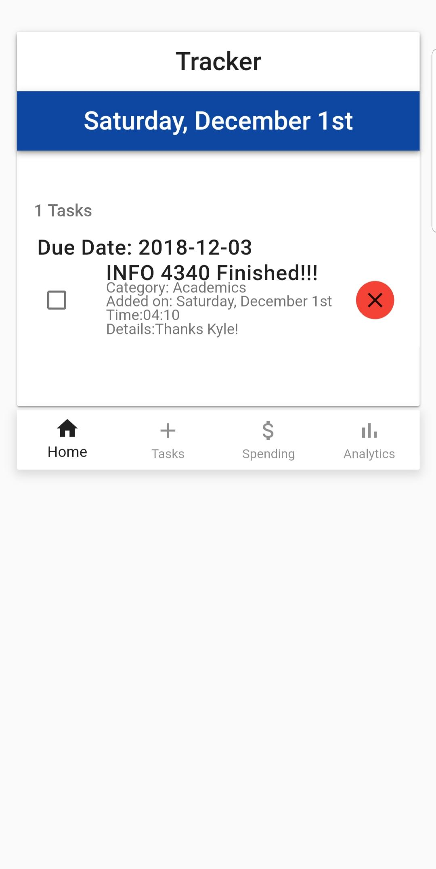
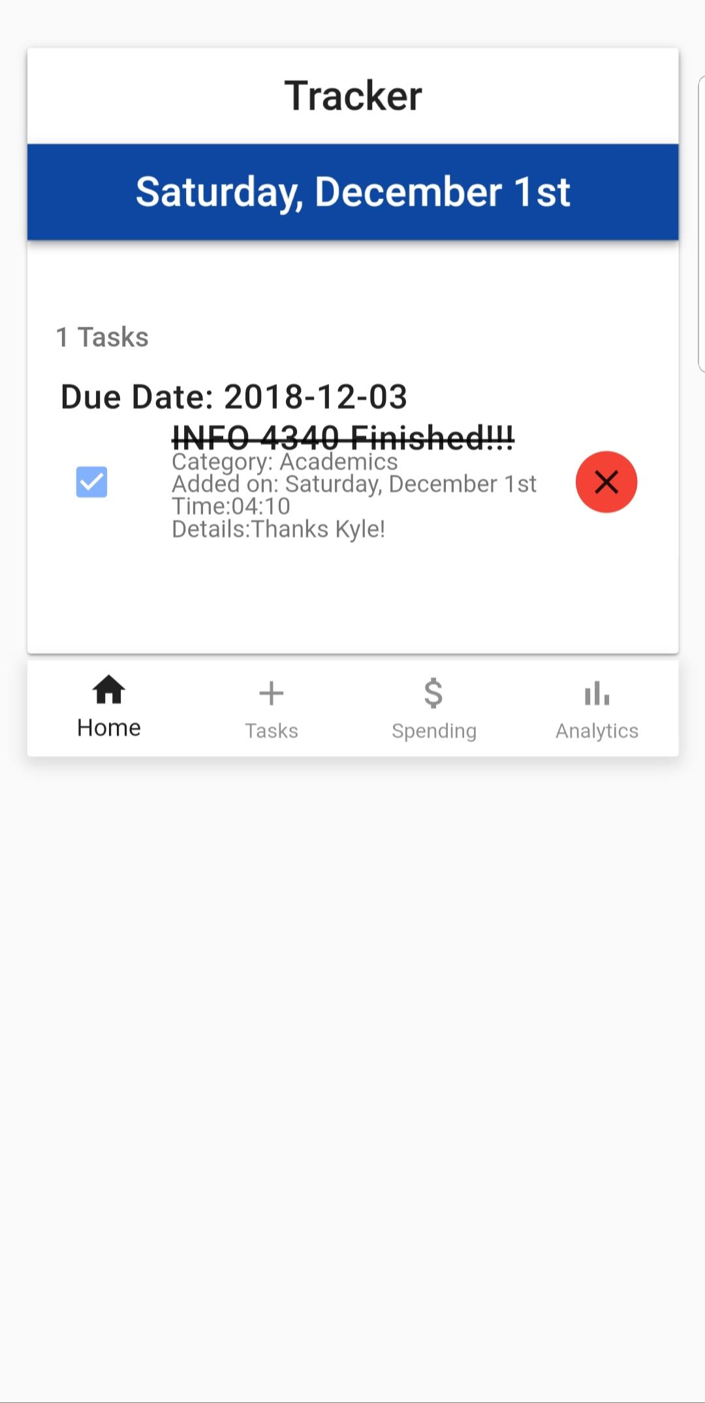
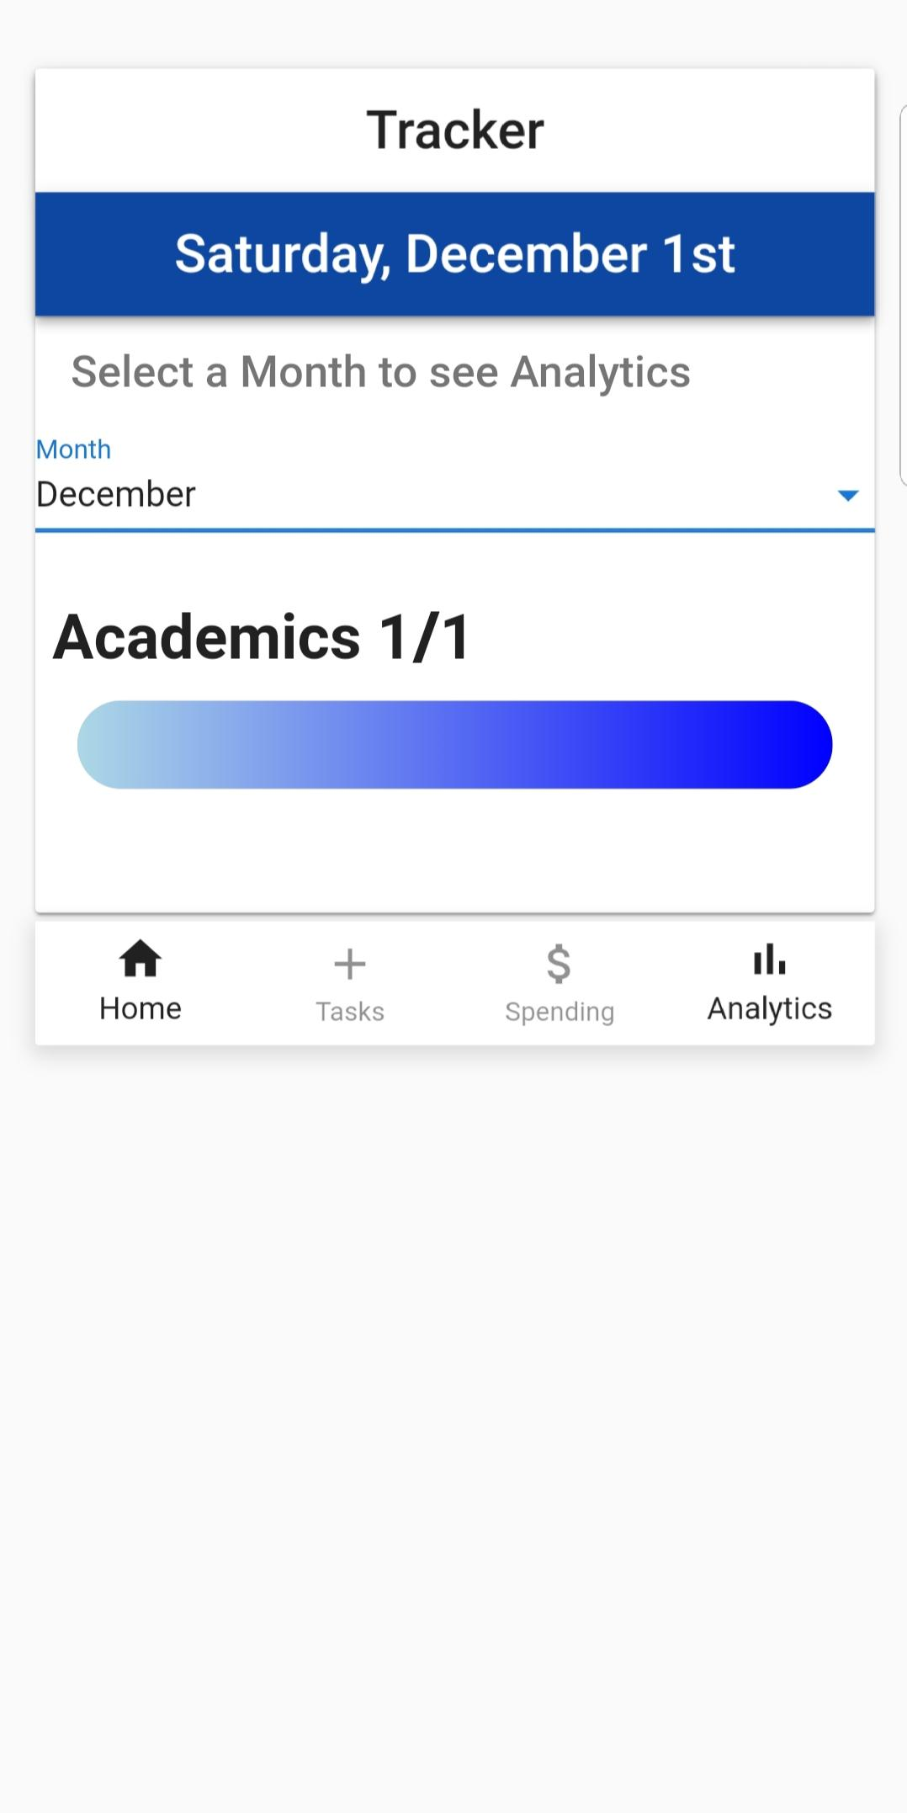
Live Demo
Please navigate to: https://git-tonic.herokuapp.com/
Notes:
Jeffrey,
Isabelle,
Priya
Angela

Slide 4
User Testing Insights/Iteration
Integrate “Set Spending Goal” to Spending Page
Display by month so that not all tasks are on home page (reduce length)
Distinguish which parts of the form are required
Fix overwriting issue on analytics page for same month of different year
Hiding/Showing tasks toggle
Repeat indefinitely - no end date
Notes:
Grace

